Slide 1
Presentation Begins
GRDN 2200
Submitted By:-
Aakashdeep Wahi
Roll No:-
8728485
Submitted To:-
Randal Kozak

Slide 2
Contents
1
2
3
About Me
Here I will describe myself and my style of work.
My Work
I will show and describe what was my work and how I made that.
Acknowlegment
Here I will mention everyone who has helped me in achieving those sklls.

Slide 3
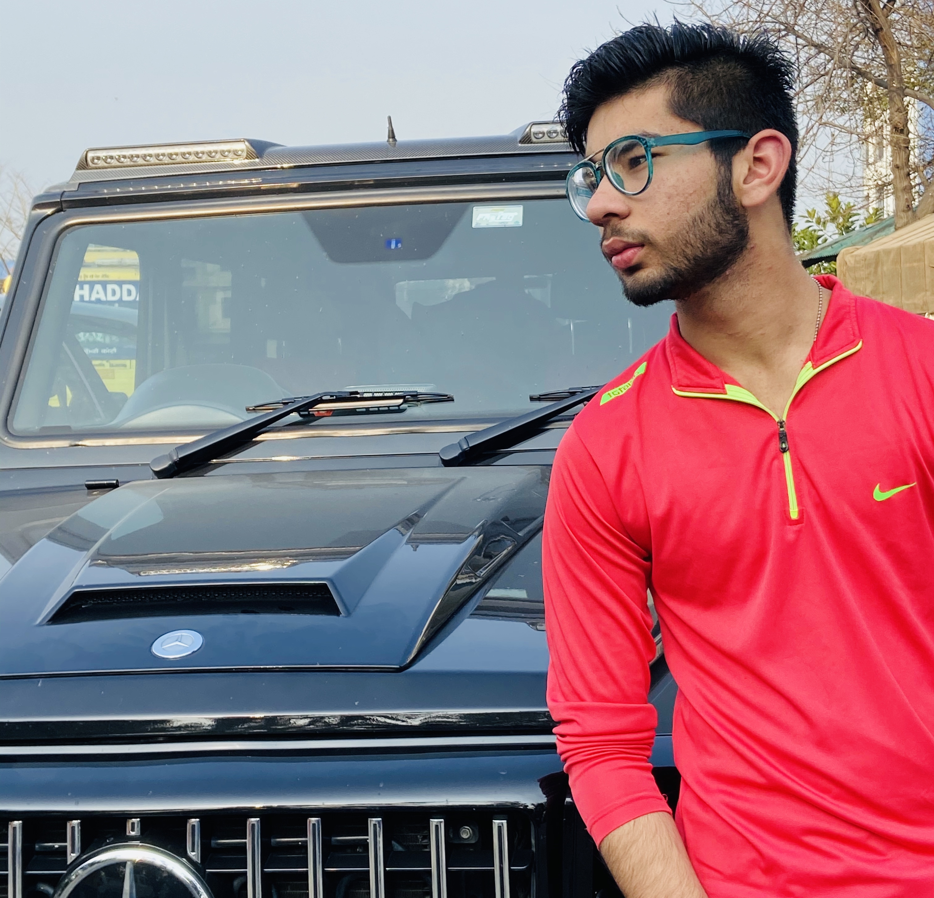
Aakashdeep Wahi (ADW)
I like do work in collaboration because I like to manage the projects. I always wanted that my work will be perfect. That’s the reason I always put my heart and soul together while working on the projects. I believe in the theory that we got only one chance to prove ourself so we have to work as if we will never regret that we can put some more efforts.

Slide 4
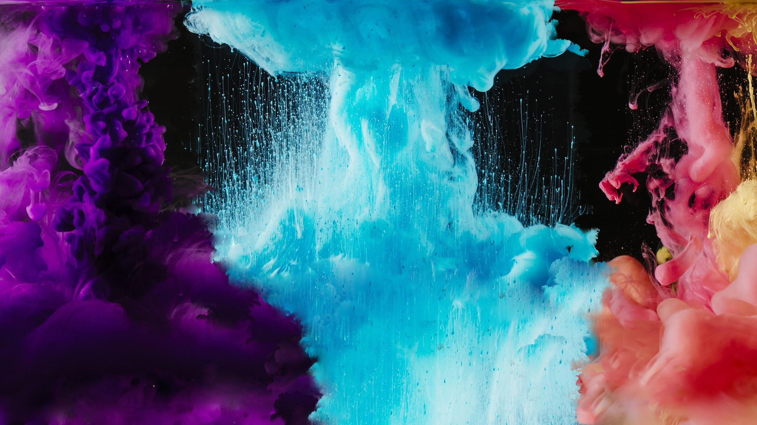
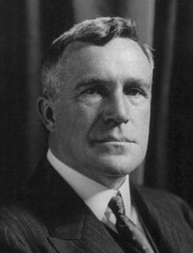
“You've got to get up every morning with determination if you're going to go to bed with satisfaction.”
—George Lorimer

Slide 5
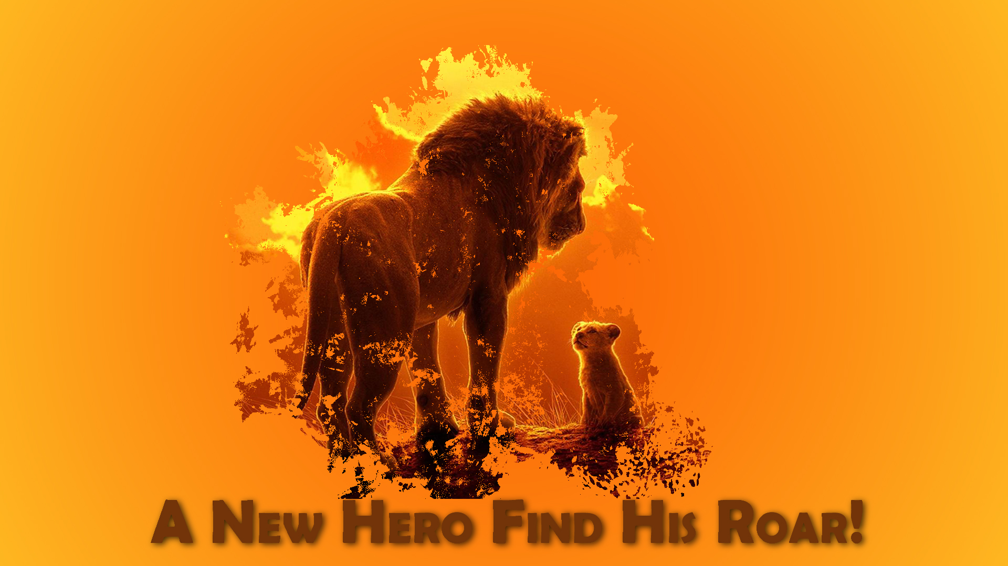
A New Hero Find His Roar
Title is basically dependent on the movie. The movie is, “The lion King”(2019).

Slide 6
Reason of Naming
I believe that a deserving candidate always just needs the direction to pursue.
Same as in the movie the lion murdered by his own brother as he wanted the kingdom. But later his cub take the crown of the jungle despite the challenges faced by the him.
Morals:-
Believe in yourself
Work should be started to be perfect
Never trust anyone blindly
Using the three principles ,“The New Hero Found his Roar!”

Slide 7
Style
Basically, this style was developed using text tool and drop shadow option. As we have used the image that we have made in earlier project. So there is nothing much to explain the development of this image.
It is clearly seen that the text is looking embedded in the image and the shadow gives a total realistic view.

Slide 8

A picture is worth a thousand words
The inspiration of this title has got from our old school classroom. This image is based on the black boards.

Slide 9
Reason of Naming
The Picture itself has thousands of memories of its own. We all remember our class time. It is very common in India to stand in front of the class and write random stuff on board. Decorating the board on various occasion is like a tradition in India. That’s why this name clearly describe this image.

Slide 10

Style
We have used the scribble filter in the text tool to make it look like hand drawn. That’s the reason it is giving such an interesting look.
I developed this style using the Text tool and the filters. The style which I have used in this image can be observed by zooming the Image. It seems like someone has used the chalk in two and forth motion again and again in a particular way to look it like letters.
Same thing we have done with heart. We have properly used the brush tool for developing many components of this picture.

Slide 11

Dream
Sir, you have already seen that I am really fond of logos. I have made several logos for myself. I want fame that I will be known by my name. I have added this too in my collection.

Slide 12



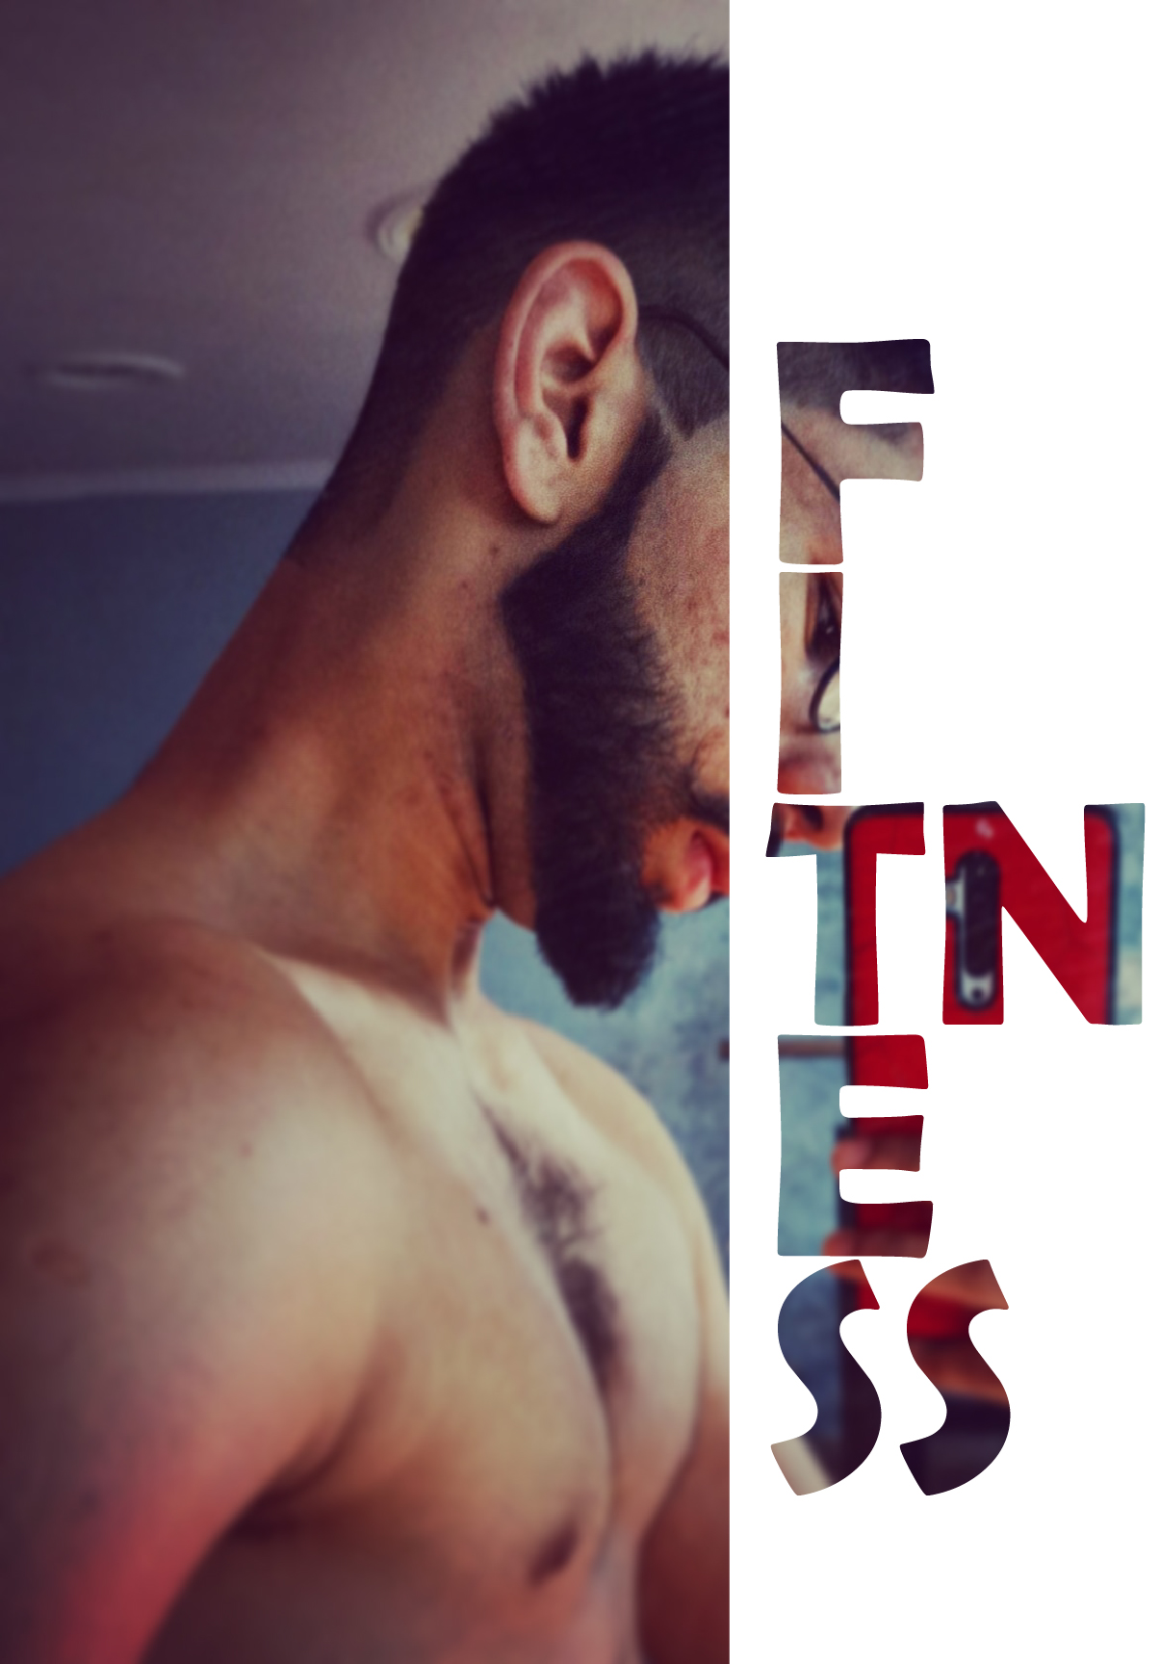
Reason of Naming
I have named this as Dream as it is a dream for me and I want to live it fully at any cost. ADW is the short form of my name I want to initiate a start-up with this name. I have made several pictures during this course for myself. It just makes me feel happy.

Slide 13
Style
In this picture we have used masking and pen tool. With the help of pen tool we have selected my picture and put it outside the letter A.
For giving my name a shadow effect we have pasted it again with different color and reduced the opacity of its.
It had given a shadow and a dual color effect on my name.

Slide 14
Awesome W ords
To be Perfect, You have to start first.

Slide 15
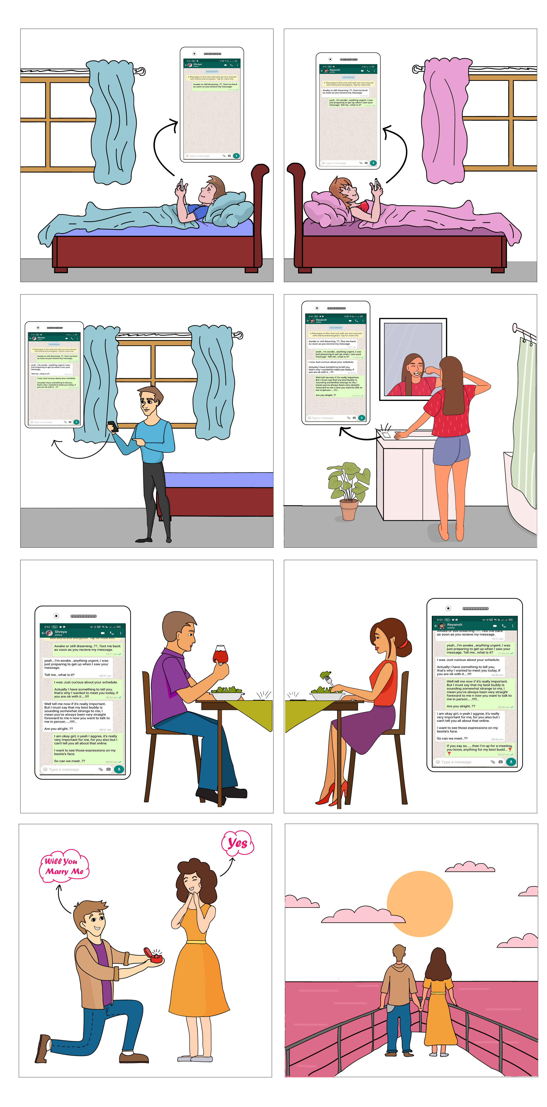
Part-B
Basically, this photo has gone through various stages. I have explained all the stages in the word file itself. So here we would discuss something new.

Slide 16

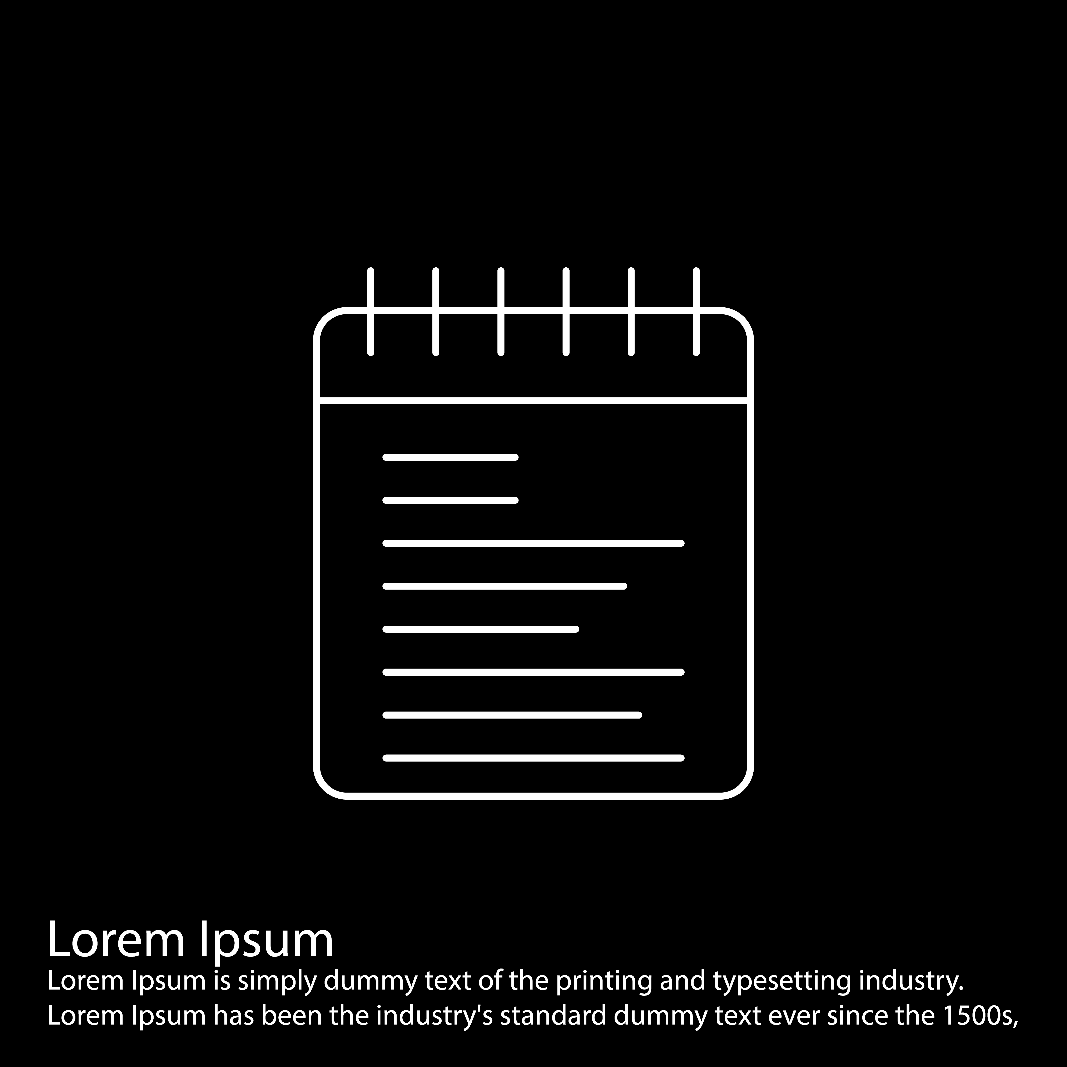
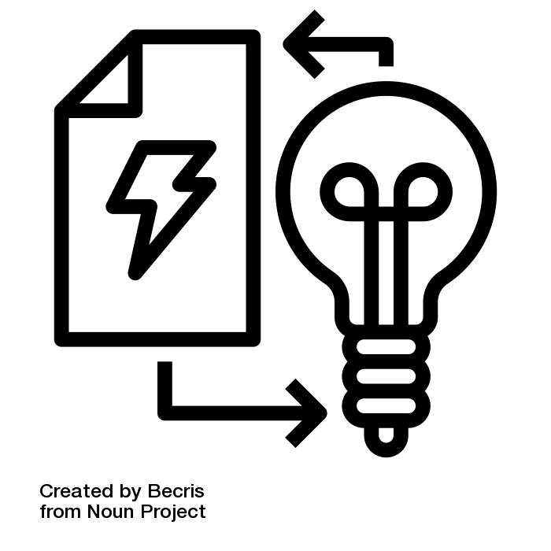
Stages of Developing
Thinking an idea
Doing Research
Execute It
First step it to think an idea which you can execute with the definite knowledge you are having. We have also developed it on paper first just to have a rough idea.
Then you have to gather all the resources that you need to develop your idea into. We have downloaded those images that helps us to develop my final part B image.
At last after gathering all the resources we just have to execute it once rest of the challenges were easy enough because you have a presure in mind that you have to complete it ☺.

Slide 17
Reasons of Developing
Well I have thought this idea as it is totally opposite of the idea that I have thought for another subject. I thought that I should also develop a thing which is a little positive and gives a positive hope.

Slide 18
Style
Well, for making this image I have used a lot of tools basically pen tool, brush tool, shape tool, shape builder tool and many more.
This photo has totally developed the color effects.
The chats which I have shown over here are the most interesting part of this picture.

Slide 19
Thanks! For Your Precious Time

Slide 20
Credits
I have tried to use free resources for most of the projects I have made. I had taken help from every possible source that I can use. I have made the project from scratch but taken ideas from multiple places. Some images were made after getting inspired.
Presentation template by Slidesgo
Images & infographics by Freepik
Background image by Freepik
Freepik.com
Big image slide photo created by Freepik

